Slide 1








Stack Overflow Developer Survey 2019
AAKASH P
15 APRIL 2024

Slide 2



OUTLINE
Executive Summary
Introduction
Methodology
Results
Visualization – Charts
Dashboard
Discussion
Findings & Implications
Conclusion
Appendix

Slide 3

EXECUTIVE SUMMARY
Current Technology Usage Trend
Top 10 Languages Worked With
Top 10 Databases Worked With
Mostly Used Software Platforms
Top 10 Web Framework Worked With
Future Technology Trend
Top 10 Language Desired Next Year
Top 10 Databases Desired Next Year
Platform Desire Next Year by Respondent
Top 10 Web Framework Desired Next Year
Demographics Survey
Respondent classified by gender
Respondent Count for Countries
Respondent Count by Age
Respondent Count by Gender, classified by Formal Education Level

Slide 4

INTRODUCTION
Study on tech software and web development Industry around the world.
Purpose of study
To identify leading programing languages, databases and web frameworks.
Identify future scope of programing languages, databases and web frameworks.
Study on Respondent by using parameters like education , age and gender.

Slide 5

METHODOLOGY
Data gathering
Source: Stack overflow
Data wrangling
Exploratory data analysis
Visualization using python
Distribution of data
Correlation of fields with each other
Dashboard using IBM COGNOS
Current Technology Usage
Future Technology Trend
Demographics

Slide 6
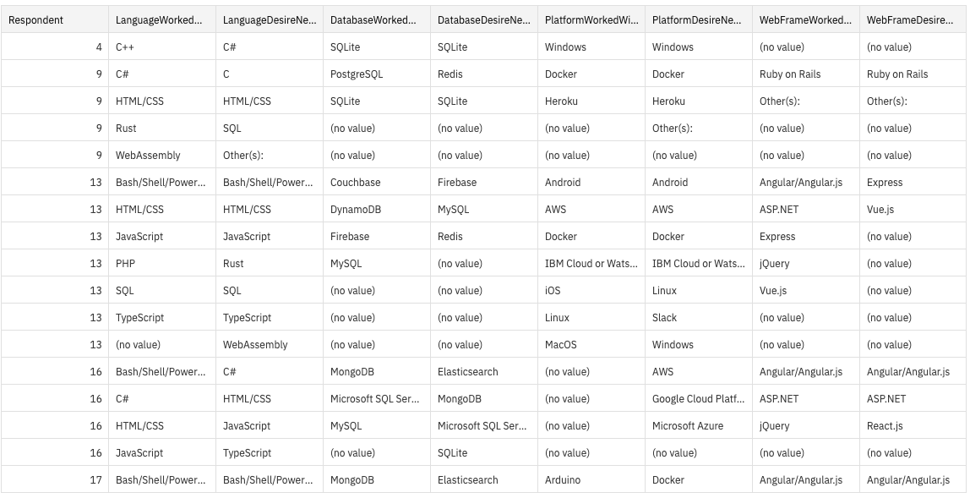
RESULTS

Slide 7
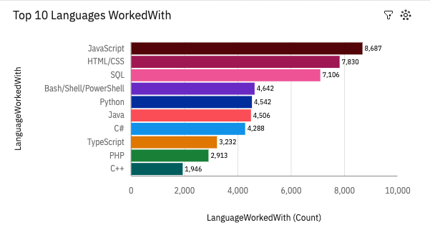
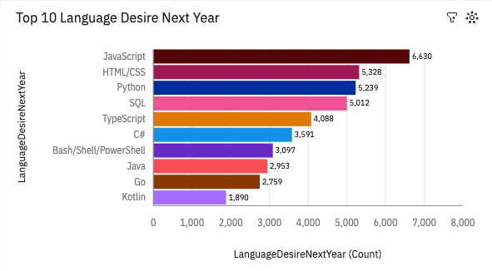
PROGRAMMING LANGUAGE TRENDS

Slide 8
PROGRAMMING LANGUAGE TRENDS - FINDINGS & IMPLICATIONS
Findings
JavaScript and HTML/CSS are booming in this year as well as next year.
Python overtakes SQL on next year and Typescript also getting highly popular.
Power shell seem losing its demand.
Implications
Python and SQL get booming It can contribute well for AI and ML (Data Science) Field
Web development and web developers are high in demand.

Slide 9
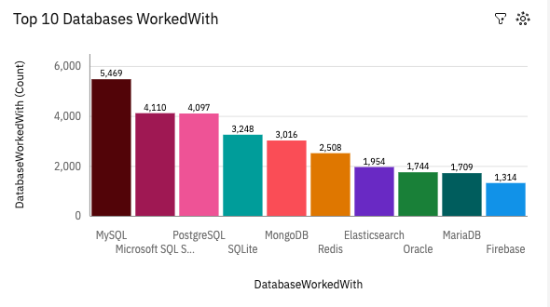
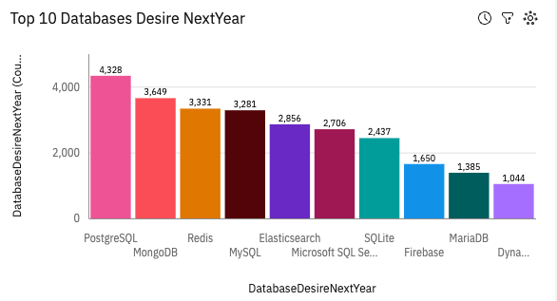
DATABASE TRENDS

Slide 10
DATABASE TRENDS - FINDINGS & IMPLICATIONS
Findings
MySQL holds First position, but in next year Postgres SQL take over MySQL
MongoDB’s Trend is increasing in coming year
NoSQL are getting in trend in upcoming year
Implications
Relational databases are inevitable for software development
NoSQL getting high in demand due to the increased volume of data in modern world
Open-Source databases are in demand.

Slide 11

DASHBOARD
https://github.com/aakashpokkanayil/Data_Science_Prep/blob/main/Components/ML/IBM%20Data%20Analyst%20Capstone%20Project/ibm%20capstone_new.pdf

Slide 12
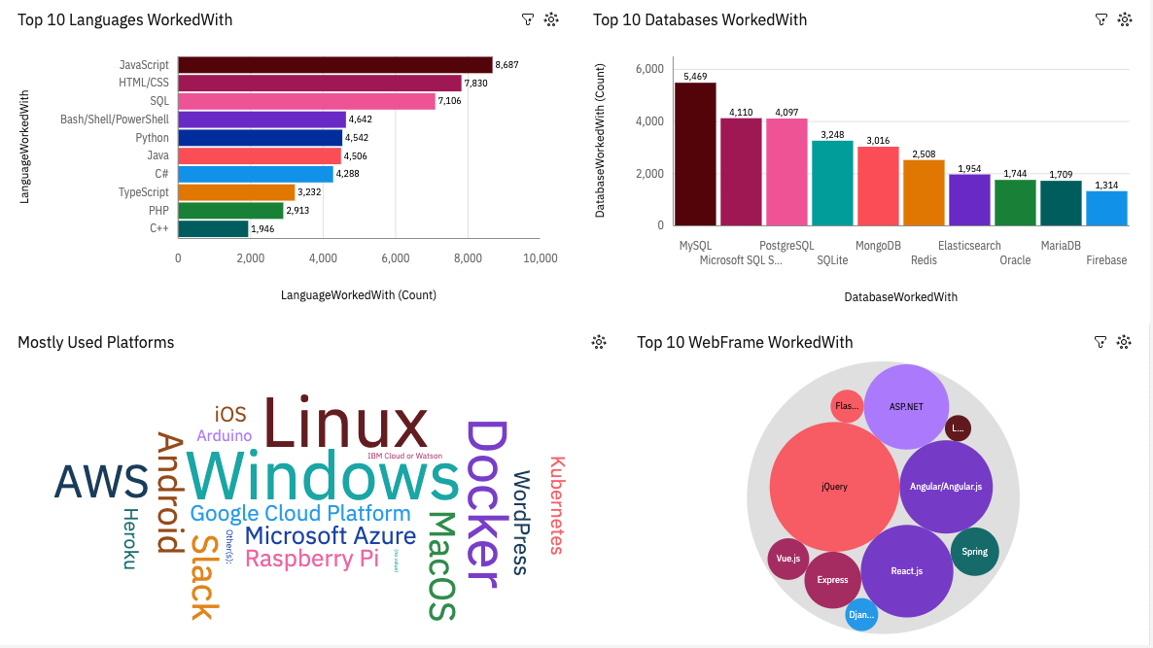
DASHBOARD TAB 1

Slide 13
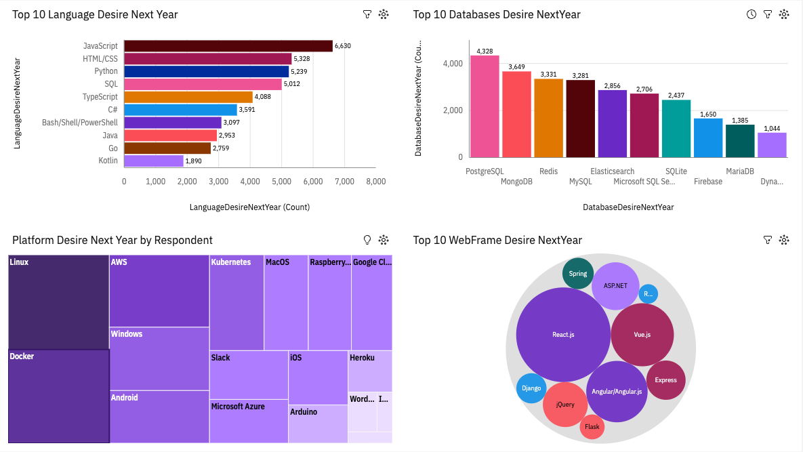
DASHBOARD TAB 2

Slide 14
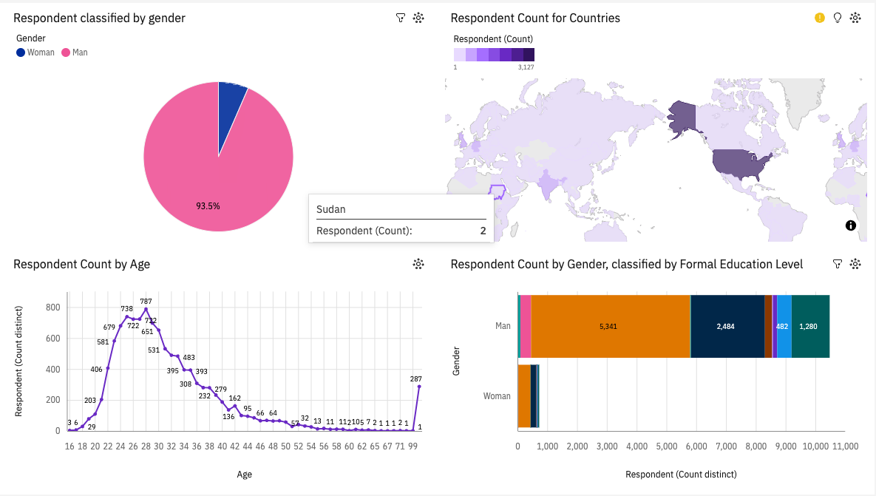
DASHBOARD TAB 3

Slide 15
DISCUSSION
Current and future technology trends
Classification of developers based on age , gender, country and education.

Slide 16
OVERALL FINDINGS & IMPLICATIONS
Findings
Technology trends are changing year by year.
USA holds the first position in developer density.
Man dominates in gender density in tech jobs.
Implications
Programmer show follow latest trends.
Technology is dense over particular region it should spread out.
There is a gender gap in industry it has to be take care.

Slide 17

CONCLUSION
Current and future technology
Demographics
Gender and education
Age Classification

Slide 18
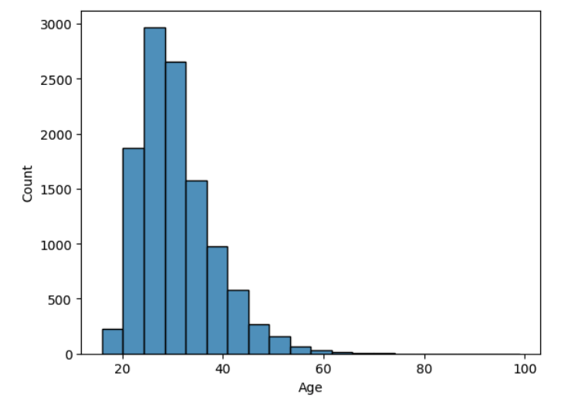

APPENDIX

Slide 19
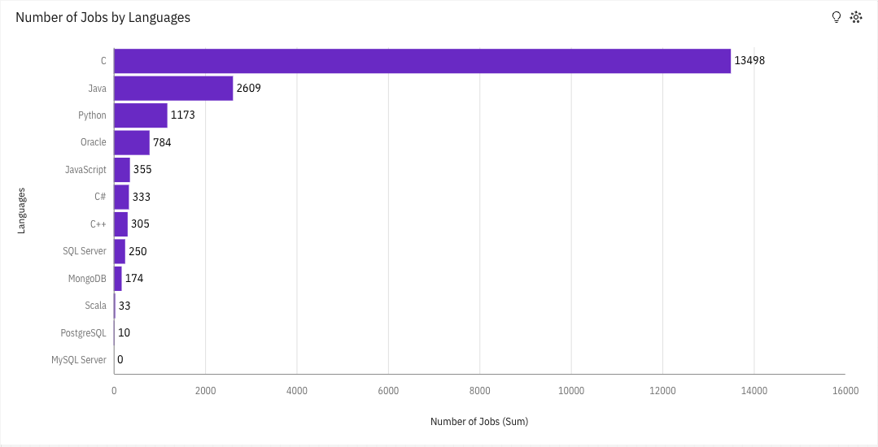
JOB POSTINGS

Slide 20
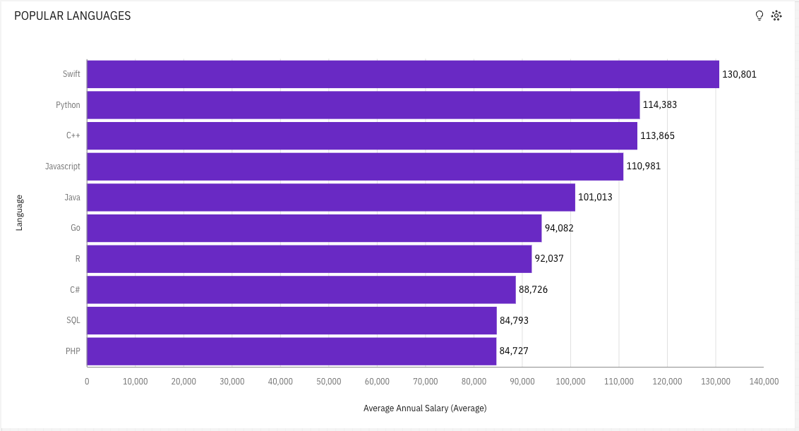
POPULAR LANGUAGES

